Slide 1

STOCK MANAGEMENT SYETEM
BY
SHRAVIKA REDDY

Slide 2
Contents
Introduction
Problem Statement
Project Scope
Project Aim And Objective
Implementation
Modules
Flow Of Project
Conclusion

Slide 3
Introduction:-
Stock Managerment is a system that will help you track your purchases, sale, current stock.

Slide 4
Problem Statement:
Investors who bought shares doesn’t get proper updates about their shares.

Slide 5
Scope Of The Project :
Is to provide a system where the investors can know about the stocks which are available in market.
To make the existing system more efficient.

Slide 6
Objective:
Develop a Stock Management System (SMS) simulation for investors to buy stocks of companies.

Slide 7
Implementation:-
Stock Management System is implemented in four phases:
Collection Framework.
JDBC.
JPA with Hibernate.
Spring boot With Angular.

Slide 8
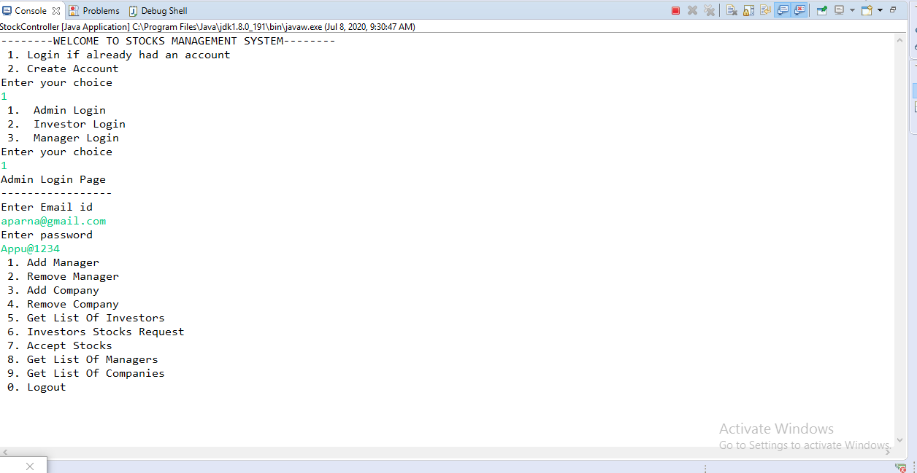
Sample Outputs

Slide 9
Modules
Admin
The administrator will be able to perform following functionalities :
User can login
CRUD operation on Company manager user
CRUD operation on Company which will be there in application to buy the stocks
Decide what is the maximum amount one investor can invest in a company
Decide what is the maximum number of stocks one investor can buy

Slide 10
Manager
The Manager can perform following functionalities:
User can login
Can change the password
CRUD operation on stocks

Slide 11
INVESTOR
Investor will be able to perform following functionalities :
User can register/login
Request for forgot password
Buy stocks
View all stocks which is bought by the user

Slide 12

Output of Spring Boot with Angular:-
1. Home Page :

Slide 13
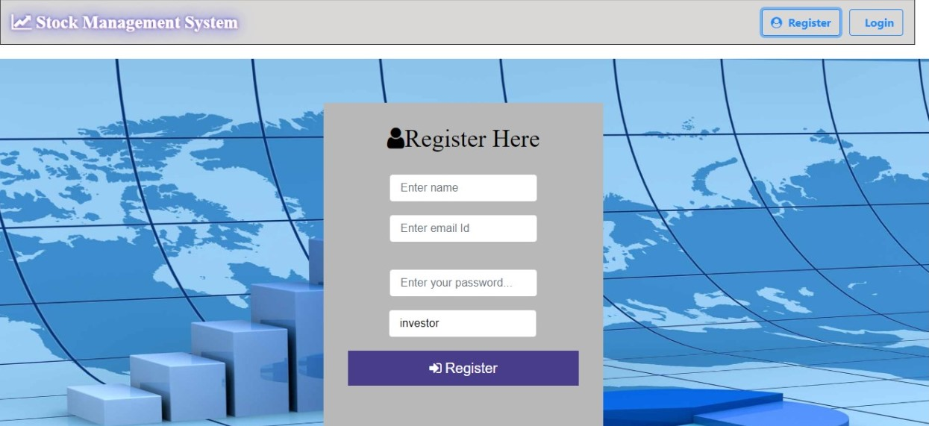
Only investor can Register.
2.Login Page:-

Slide 14
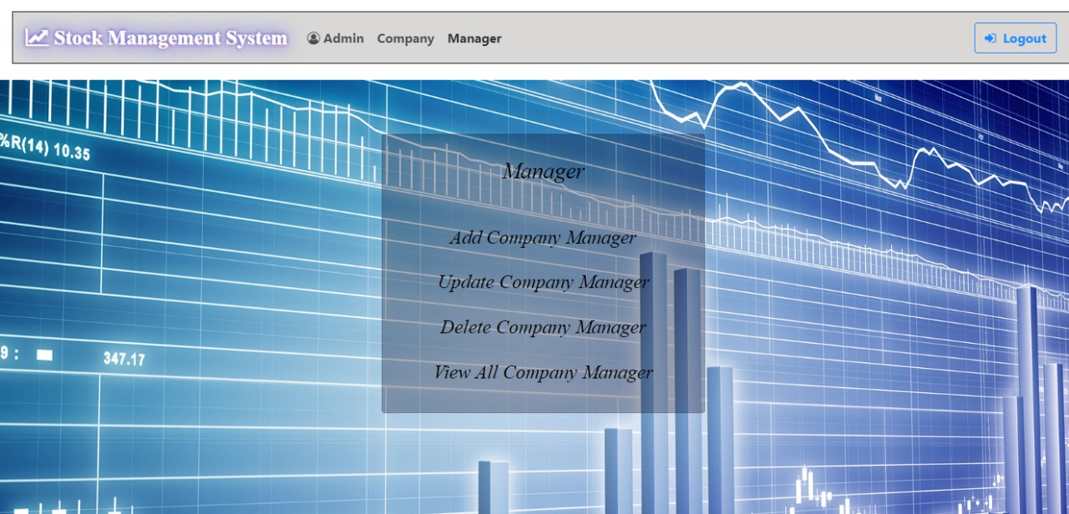
Admin can do operations on companies and company managers.
3.Admin Operations:-

Slide 15
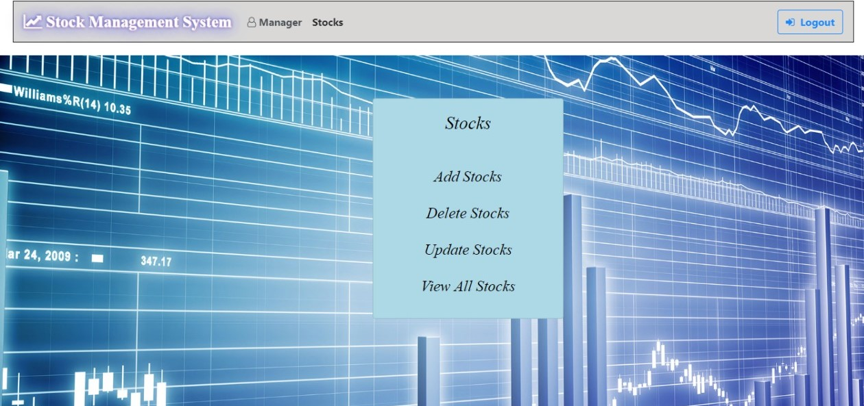
manager will perform all crud operations on stocks.
4. Manager Operations:-

Slide 16
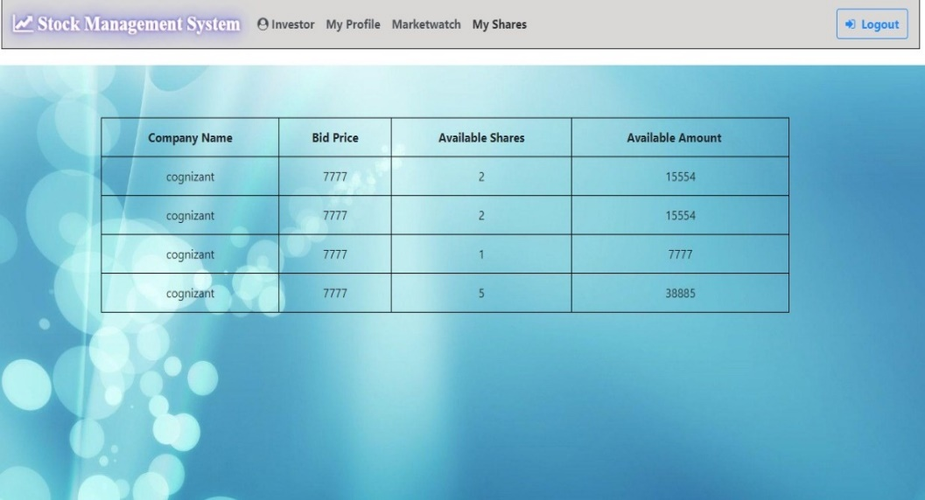
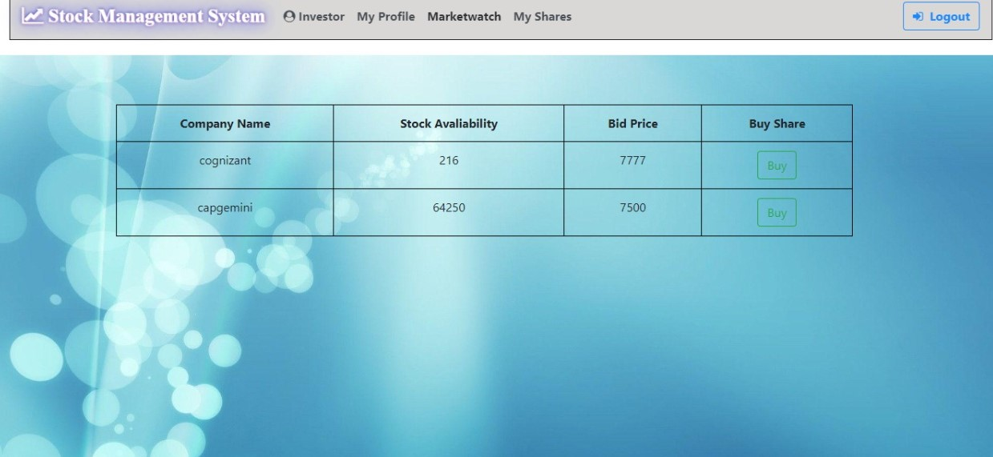
Investor can Buy the stocks and can see their shares.
5. Investor Operations:-

Slide 17
Conclusion
This new System is expected to give benefits to the users in terms of efficiency in the usage of stock management.

Slide 18
Thank You

